Slide 1

EDUCATIONAL PLATFORM FOR LEARNING IoT
Department of INTERNET OF THINGS
(Supervisor: Ms. Neha Katiyar)
Group Members
Name of Member | Roll Number | Role
Ayush Sharma | 2101331550022 | Managing Documentation
Jatin Kumar | 2101331550038 | Managing Styling
Sachin Rawat | 2101331550067 | Managing Structure

Slide 2
Introduction
Internet of thing is an emerging technology and the potential of IOT cannot be measured via some states ,so there are many people who want to know more about IOT .
And as a student who is going to pursue career in IOT we want to contribute in its advancement however we can ,so we are creating a learning platform for Internet of thing .
The goal is simple to build a single platform for learning IOT so we learned about web development to create one.
Learning platform for Internet of Things

Slide 3
Literature Survey
Researcher | Abstract | Publish year
Andre Hora | Developers often search for software resources on the web. In practice, instead of going directly to websites thus not finding what they really want to know.[1] | 2021
Chengkun | Web search queries reveal extensive sensitive information about users’ interests and preferences to the search engines and eavesdroppers.[2] | 2018

Slide 4
Literature Survey
Researcher | Abstract | Publish year
Aaron Paul M. Dela Rosa | applications development, e-learning, Mandarin Chinese language, web applications, web development[3] | 2023
João Pedro Cunha | web development, cybersecurity, vulnerabilities, owasp[4] | 2022

Slide 5

Problem Statement
When someone want to learn about IOT they have to refer different platform .
Not a single learning platform where you get a to z things about IOT .
Searching for specific topic on different platform leads to time waste and kills productivity .

Slide 6
Proposed Methodology
Website 1
Website 2
Website 3
IOT website
Better and ordered SEQUENCE OF DATA TO USER

Slide 7
IOT Website
HOME
PROJECTS
SIMULATOR
TRY PREMIUM
REGISTER
ARDUINO
DEFINITION
IDEAS
TINKERCAD
COMING SOON
EXAMPLES
LINKS
PROTEUS

Slide 8
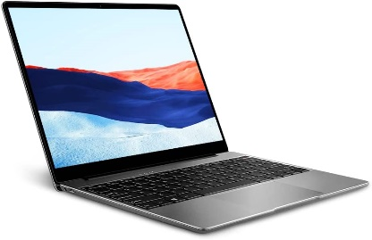
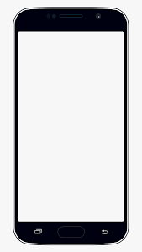



Hardware /Software Requirements
To use :-
Smart phone/computer with a internet connectivity
To develop:-
html 5 ,CSS 3 , IDE ( vs code version 1.73 )

Slide 9
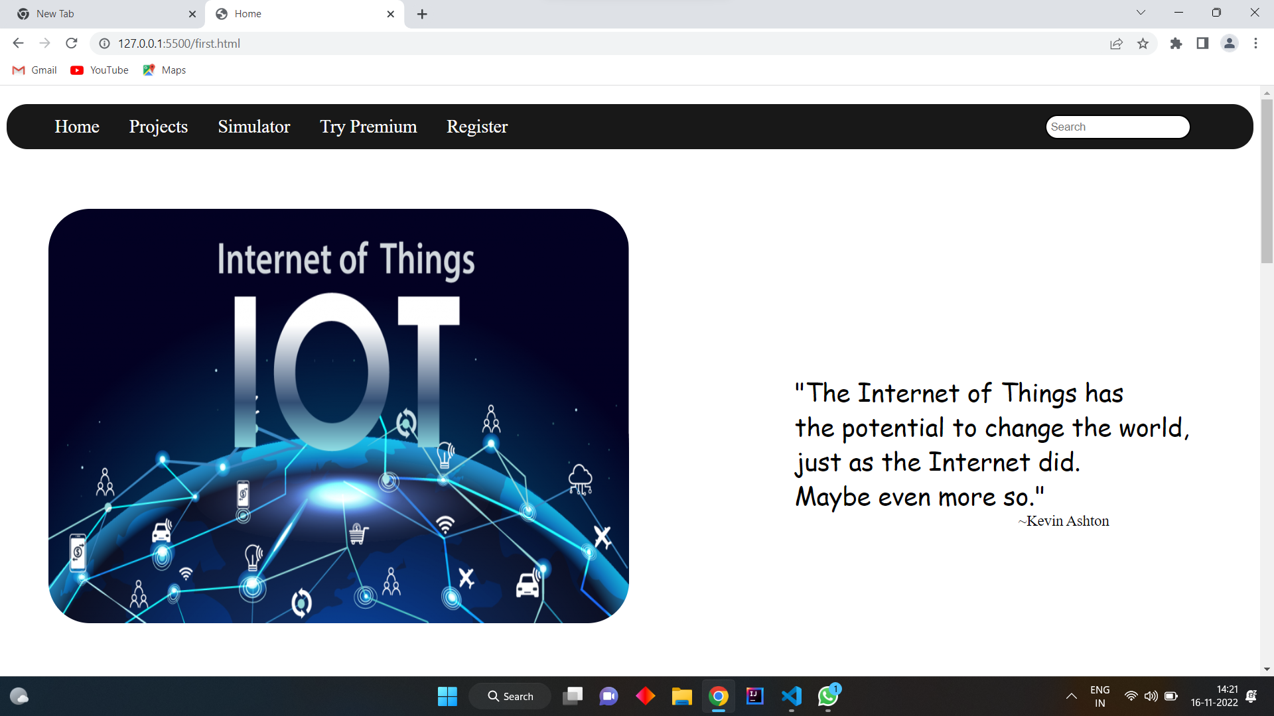
Live Project Progress

Slide 10
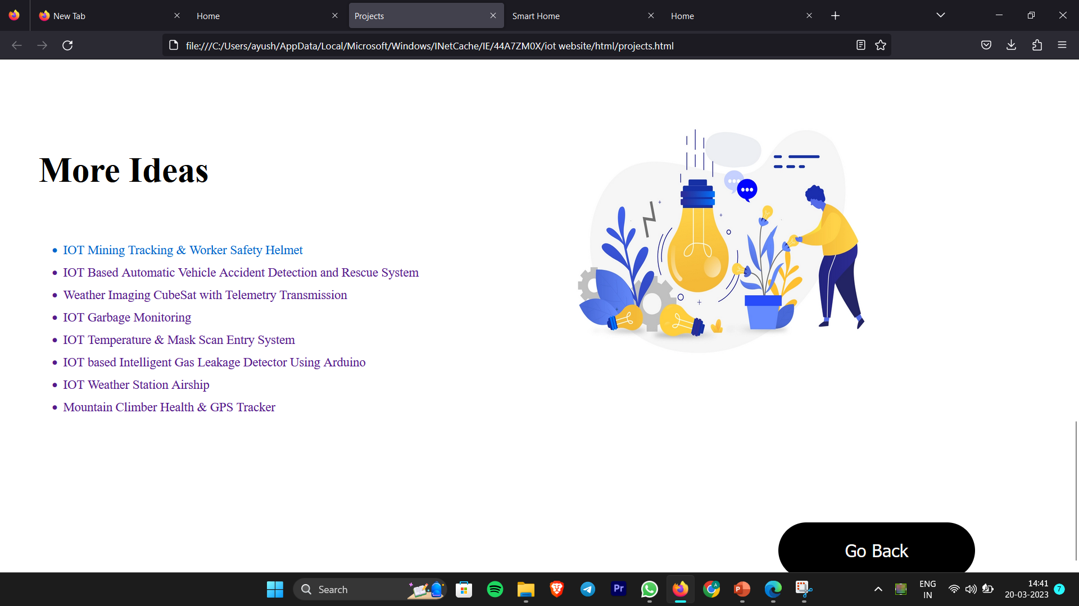

Slide 11
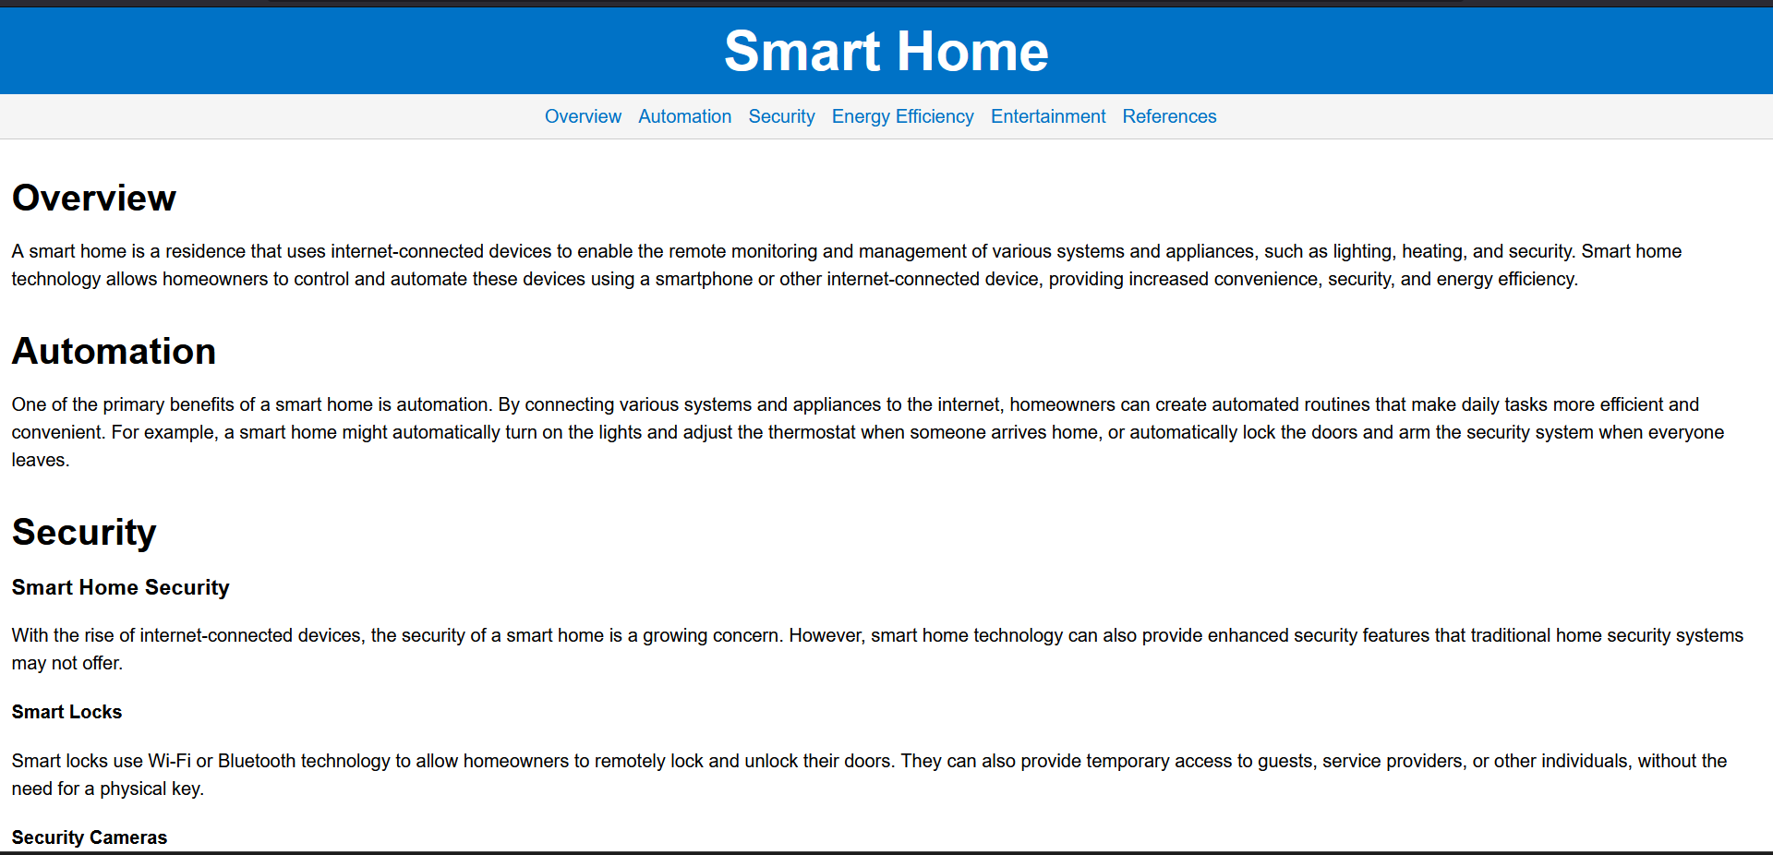

Slide 12
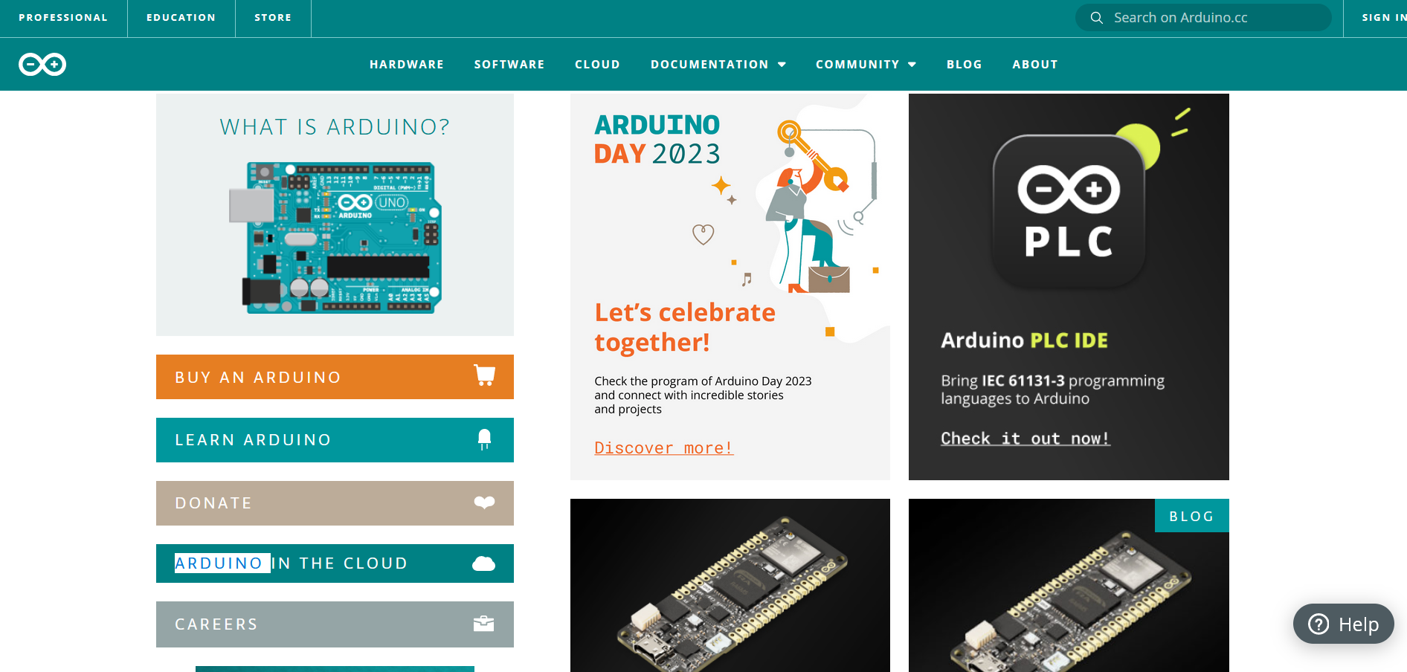

Slide 13

Future action plan
Implement on global level
Implement IOT labs in our website
Implement live project demo
Implement video lectures
Launch courses
Including projects which made at NIET

Slide 14
References
[1] 2021 IEEE/ACM 18th International Conference on Mining Software Repositories (MSR)
[2] DOI 10.1109/TDSC.2019.2962440, IEEE
[3] Internet Of Things: Architecture and Design by MC Graw Hill publication. [4] OWASP "A04:2021 – Insecure Design” [Online]: https://owasp.org/Top10/A04_2021-Insecure_Design/, 2023 [Fev. 15, 2023].
[5]OWASP "A09:2021 – Security Logging and Monitoring Failures [Online]: https://owasp.org/Top10/A09_2021-Security_Logging_and_Monitoring_Failures/, 2023 [Fev. 20, 2023].

Slide 15
Thank You

